Slide 1
Fake News Detection using Machine Learning
TEAM TRIFORCE
* MEENAKSHI SUNDARAM.V (URK21CS7007)
* KARANAM NEETHA REDDY (URK21CS7039)
* NAGOTHU SRAVANI VIMALA RANI (URK21CS2033)

Slide 2
ABSTRACT
Fake news detection is a crucial task in today's information-rich digital landscape. This project focuses on developing a machine learning model for accurately identifying fake news articles. By leveraging a dataset of genuine and fake news articles, the model aims to classify news articles and differentiate between legitimate and fabricated information. Through text preprocessing, TF-IDF vectorization, and the application of the PassiveAggressiveClassifier algorithm, the model achieves accurate classification of news articles. This project emphasizes the importance of text preprocessing and hardware optimization for efficient and effective fake news detection.

Slide 3
INTRODUCTION
Fake news poses a significant challenge in today's digital era, requiring effective solutions to identify and combat its spread. This project focuses on leveraging machine learning techniques to develop a reliable and scalable approach for detecting fake news. With the rapid growth of information sharing on the internet, the spread of fake news has become a significant concern. Fake news can have severe consequences, including influencing public opinion, damaging reputations, and undermining trust in media and institutions. Therefore, the ability to automatically identify and classify fake news articles is of great importance.

Slide 4
MOTIVATION BEHIND THE PROBLEM
The ease of information sharing and the rapid dissemination of news through social media platforms have contributed to the rapid spread of misinformation. The consequences of fake news are far-reaching, including the potential to sway public opinion, create social unrest, and undermine trust in media and institutions.
The motivation behind this project lies in the urgent need to combat the spread of fake news and promote accurate information dissemination. By developing a machine learning model for fake news detection, we aim to provide a proactive solution to identify and classify misleading or fabricated news articles. Such a model can assist individuals, media organizations, and fact-checking agencies in verifying the authenticity of news and preventing the propagation of false information. By leveraging machine learning techniques, we aspire to foster a more informed and discerning society, where the spread of misinformation is mitigated, and accurate information prevails.

Slide 5
PRIOR RESEARCH
Prior research on fake news detection has explored manual fact-checking, rule-based systems, and machine learning approaches. Manual fact-checking is accurate but time-consuming. Rule-based systems struggle to adapt to evolving fake news tactics. Machine learning techniques have gained prominence, employing algorithms to learn patterns from labeled datasets. Feature engineering, including TF-IDF and metadata analysis, enhances detection. Various algorithms, ensembles, and hybrid methods have been utilized. Challenges include handling sophisticated fake news, adversarial attacks, and evolving strategies. Ongoing research focuses on resilience, scalability, and interpretability, utilizing deep learning and network analysis. The field continues to advance toward reliable and scalable solutions to combat the spread of fake news and promote information integrity.

Slide 6
OUR APPROACH
Dataset Preparation: We start by importing and combining two CSV files containing genuine and fake news articles. We assign labels to indicate the authenticity of each article.
Exploratory Data Analysis (EDA): We conduct EDA to gain insights into the dataset, visualize the distribution of news articles based on subjects, and preprocess the text data by removing irrelevant information.
Model Training: We split the preprocessed text data into training and testing sets. The text data is transformed into numerical features using the TF-IDF vectorization technique. We train a PassiveAggressiveClassifier, a machine learning algorithm known for its effectiveness in text classification tasks.

Slide 7
OUR APPROACH (CONTD..)
4. Model Evaluation: We evaluate the performance of the trained model by making predictions on the test set. We calculate the accuracy score to measure the model's ability to correctly classify news articles. We also generate a confusion matrix to gain further insights into the model's predictions.
5. Patching and Unpatching Scikit-learn: We compare the training time and accuracy of the model using the patched and original scikit-learn libraries. The patched library utilizes the Intel® extension, optimizing computations and accelerating the training process.
By combining these steps, we develop a machine learning model that effectively detects fake news articles. This approach leverages the power of text preprocessing, TF-IDF vectorization, and the PassiveAggressiveClassifier algorithm to accurately classify news articles. The comparison between the patched and original scikit-learn libraries provides insights into the benefits of hardware optimization for training time and accuracy.

Slide 8
RESULTS
The results of our experiments indicate the effectiveness of the machine learning model in detecting fake news. The accuracy scores achieved demonstrate the model's ability to distinguish between genuine and fake news articles. The confusion matrix provides a detailed breakdown of the model's predictions, revealing areas of success and potential weaknesses.
The comparison between the patched and original scikit-learn libraries allows us to assess the efficiency gains obtained from utilizing the Intel® extension. This analysis provides insights into the benefits of leveraging hardware acceleration for machine learning tasks.

Slide 9
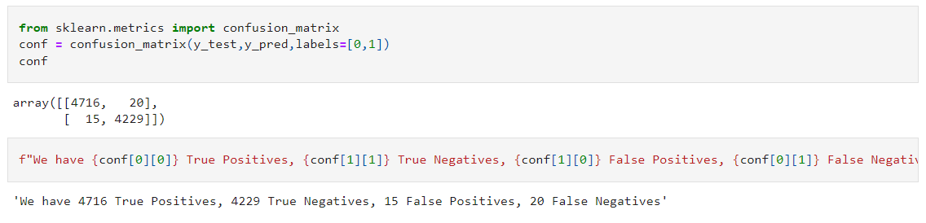
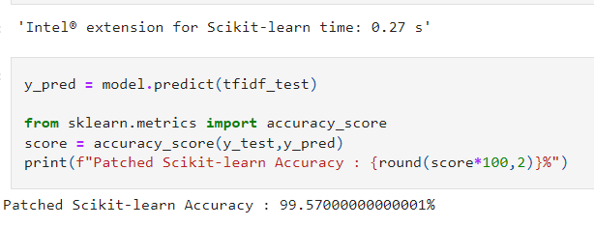
RESULTS (CONTD..)

Slide 10
REFERENCES
1.https://onlineacademiccommunity.uvic.ca/isot/2022/11/27/fake-news-detection-datasets/
2. https://paperswithcode.com/task/fake-news-detection
3. https://www.sciencedirect.com/science/article/pii/S1877050918318210
4. https://arxiv.org/abs/1901.08232
5. https://arxiv.org/abs/1801.02421

Slide 11
LINK TO SOLUTION
https://github.com/Itssundarr/Triforce_KarunyaInstitute_Fake-news-detection

